Slide 1
Data Structures and Algorithms
Workshop

Slide 2
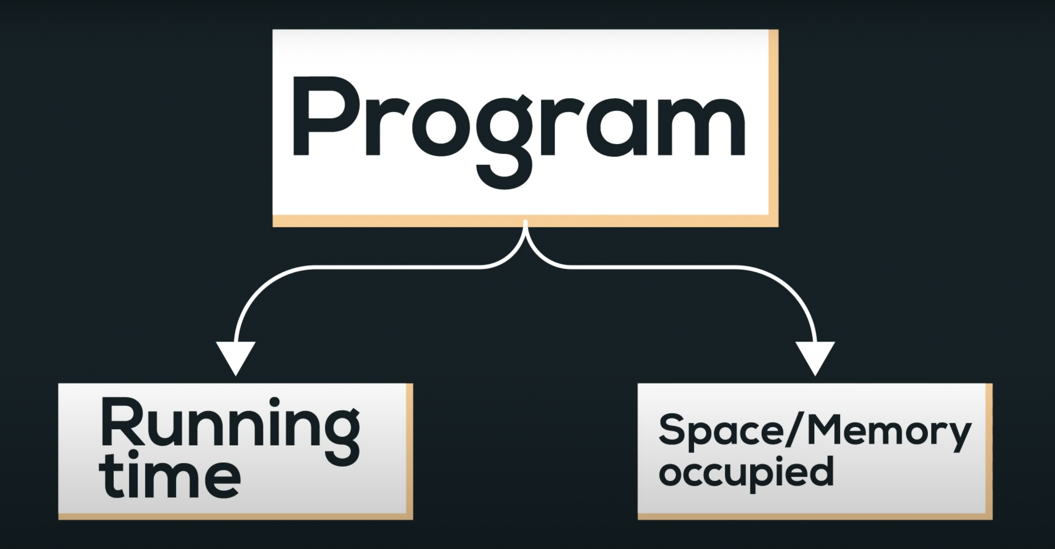

Slide 3
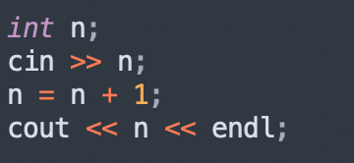
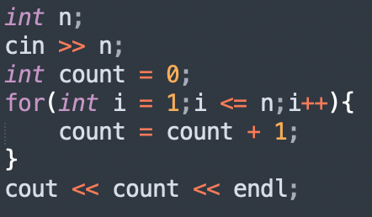
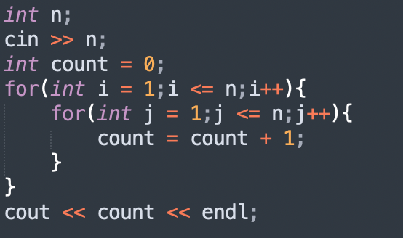
Time complexity
Time Complexity of an algorithm quantifies the amount of time taken by a program to run as a function of length of the input.
The Time Complexity of an algorithm/code is not equal to the actual time required to execute a particular code, but the number of times a statement executes.

Slide 4
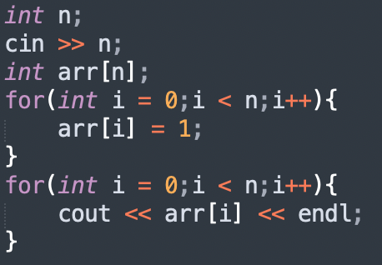
Space complexity
The space Complexity of an algorithm is the total space taken by the algorithm with respect to the input size.
It is directly proportional to the largest memory your program acquires at any instance during runtime.

Slide 5
Worst, Average & Best Cases
Worst Case Analysis (Mostly used) - In the worst-case analysis, we calculate the upper bound on the running time of an algorithm.
We must know the case that causes a maximum number of operations to be executed.
We define an algorithm’s worst-case time complexity by using the Big-O notation.
2 | 3 | 7 | 5 | 10 | 1 | 11 | 8
Target Value -
Case 1: 2
Case 2: 10
Case 3: 8
Case 4: 15

Slide 6
Best Case Analysis: In the best case analysis, we calculate the lower bound on the running time of an algorithm.
We must know the case that causes a minimum number of operations to be executed.
We define an algorithm’s best-case time complexity by using the Omega notation Ω(1) .
In the linear search problem, the best case occurs when target is present at the first location.
Average Case Analysis - In average case analysis, we take all possible inputs and calculate the computing time for all of the inputs.
Sum all the calculated values and divide the sum by the total number of inputs. We must know (or predict) the distribution of cases.
We define an algorithm’s best-case time complexity by using the Theta notation Ω(1) .

Slide 7
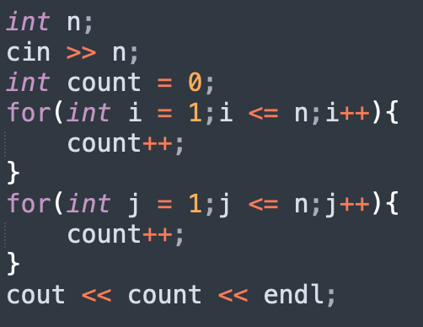
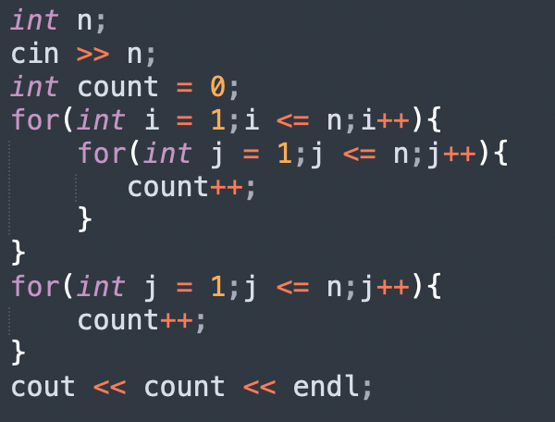

Slide 8
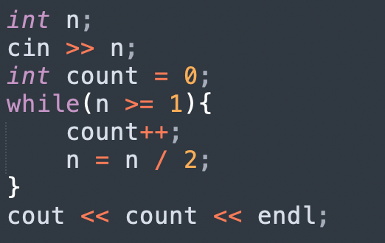
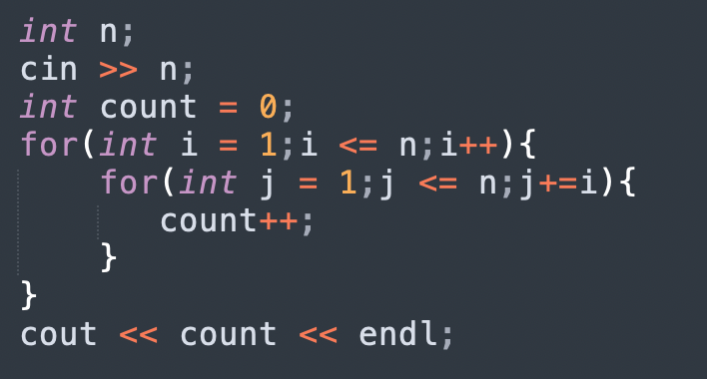

Slide 9
Comparison of various time complexities
n | O(n) | O(n²) | O(n³) | log(n)
1 | 1 | 1 | 1 | 1
10 | 10 | 10² | 10³ | 3
10² | 10² | 10⁴ | 10⁶ | 7
10³ | 10³ | 10⁶ | 10⁹ | 10

Slide 10
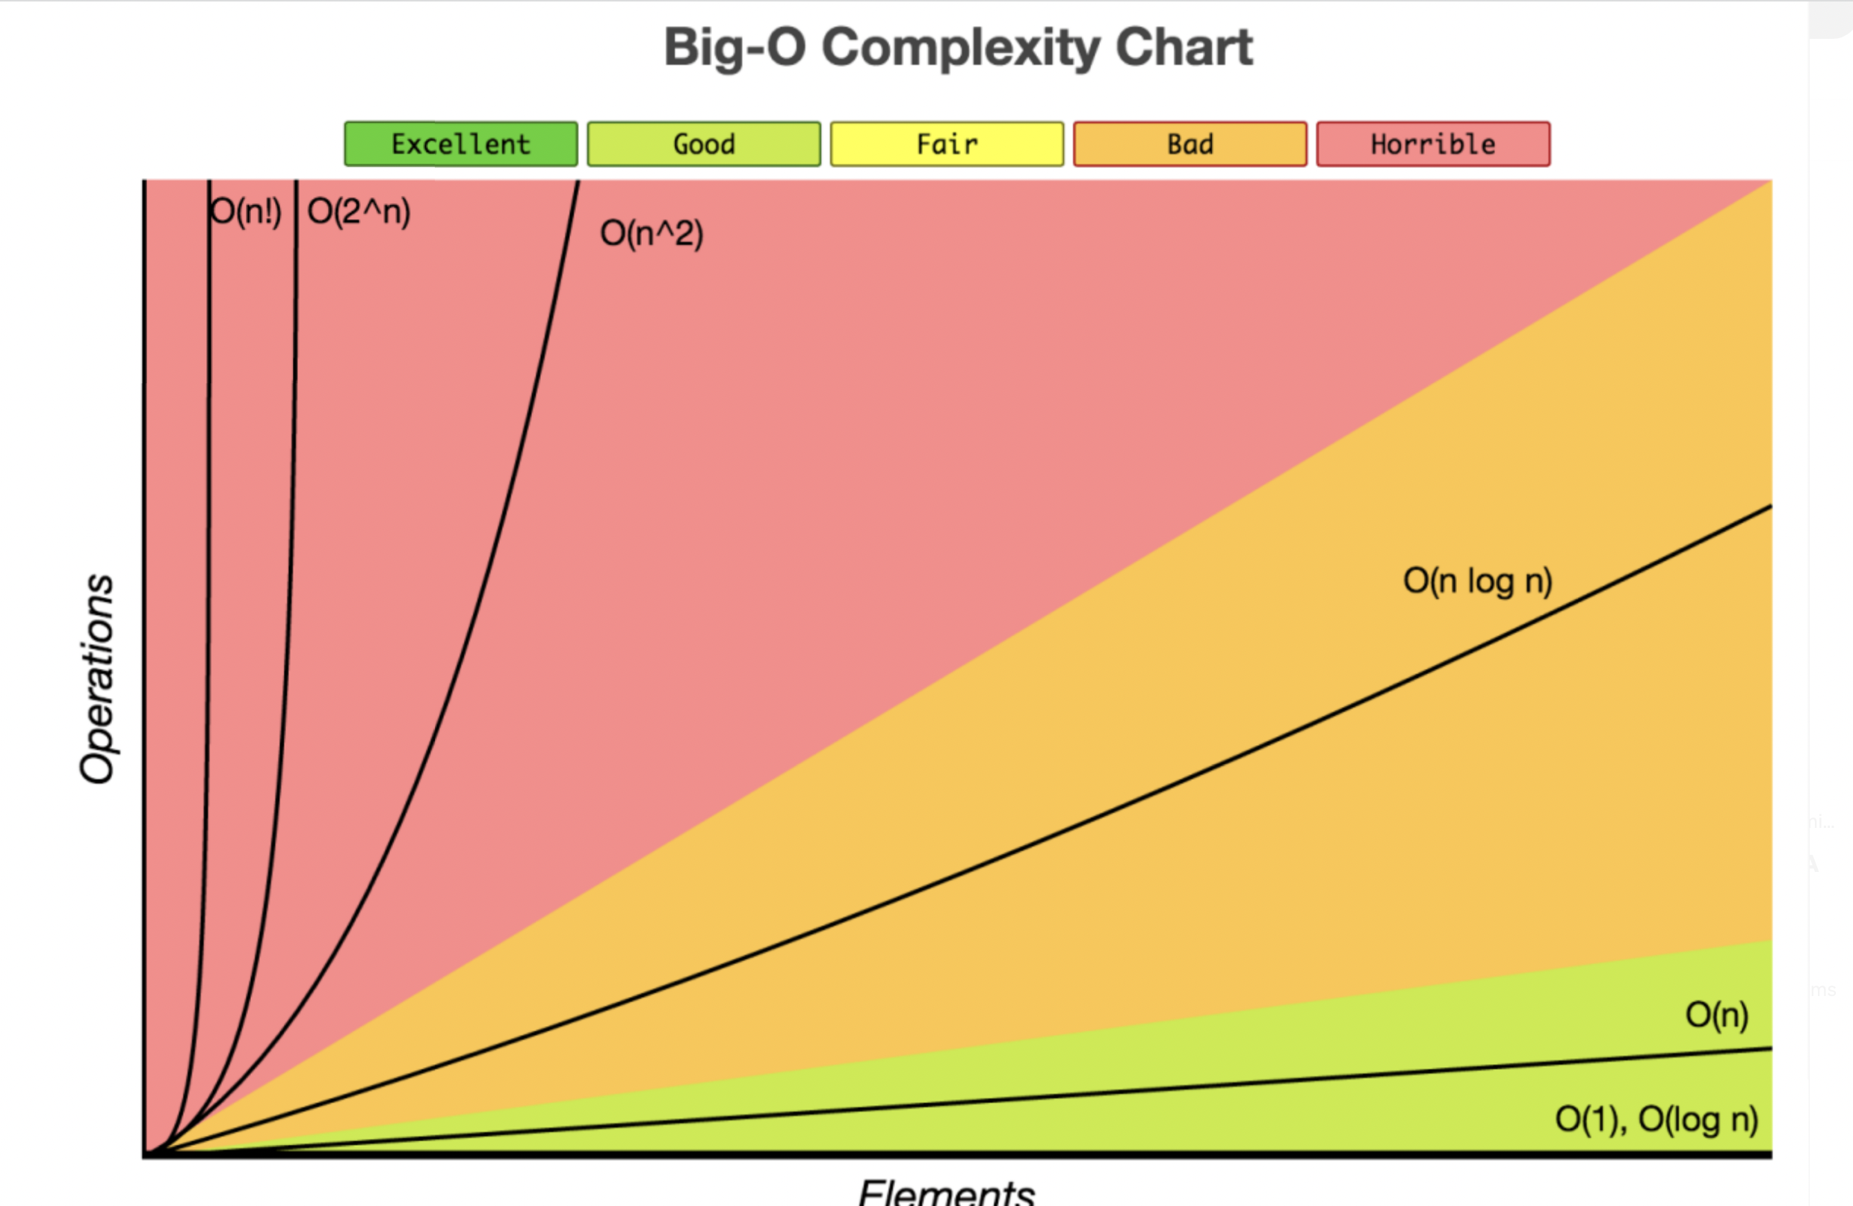

Slide 11
Importance of Time complexity
Time complexity is one of the most important factors in determining the efficiency of your code.

Slide 12
Binary search
Binary Search is a searching algorithm used for finding an element's position in a sorted array. It is one of the most important algorithms in the world.
Binary search follows the divide and conquer approach in which the list is divided into two halves, and the item is compared with the middle element of the list.
If the match is found then, the location of the middle element is returned. Otherwise, we search into either of the halves depending upon the result produced through the match.
Index | 0 | 1 | 2 | 3 | 4 | 5 | 6
Array | 2 | 3 | 5 | 6 | 8 | 10 | 12

Slide 13
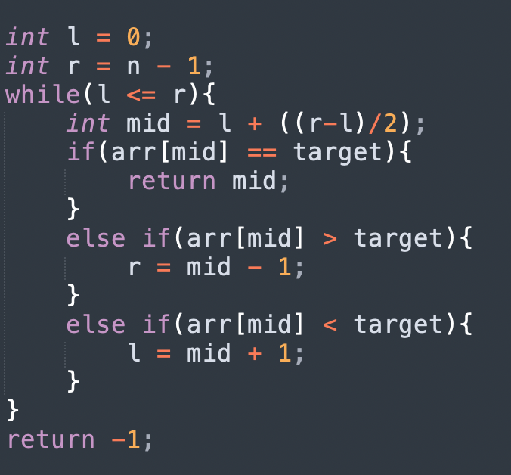
Implementation of Binary search

Slide 14
Quick Assessment
You have been given a number n. Check if the given number is perfect square or not.
You have been given n numbers. Return the first number greater than or equal to x.
Find the maximum element in an array which is first increasing and then decreasing.

Slide 15
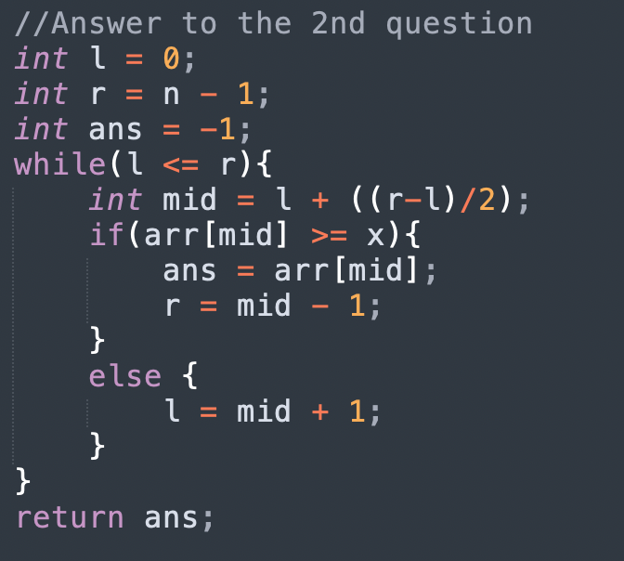

Slide 16
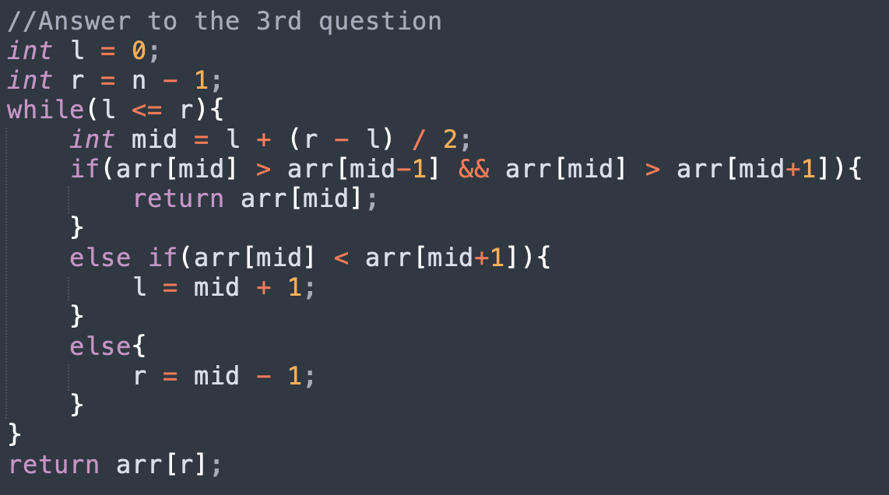

Slide 17
BINARY SEARCH ON ANSWER
Binary search can be applied to all problems where the state of a condition changes only once.
Multiple true followed by multiple false or multiple false followed by multiple true values.
Problems –
Mic Testing Problem
Wood Cutting Problem

Slide 18
Two pointers
Two pointers is really an easy and effective technique that is typically used for searching pairs in a sorted array.
Q. Given a sorted array A (sorted in ascending order), having N integers, find if there exists any pair of elements (A[i], A[j]) such that their sum is equal to X.

Slide 19
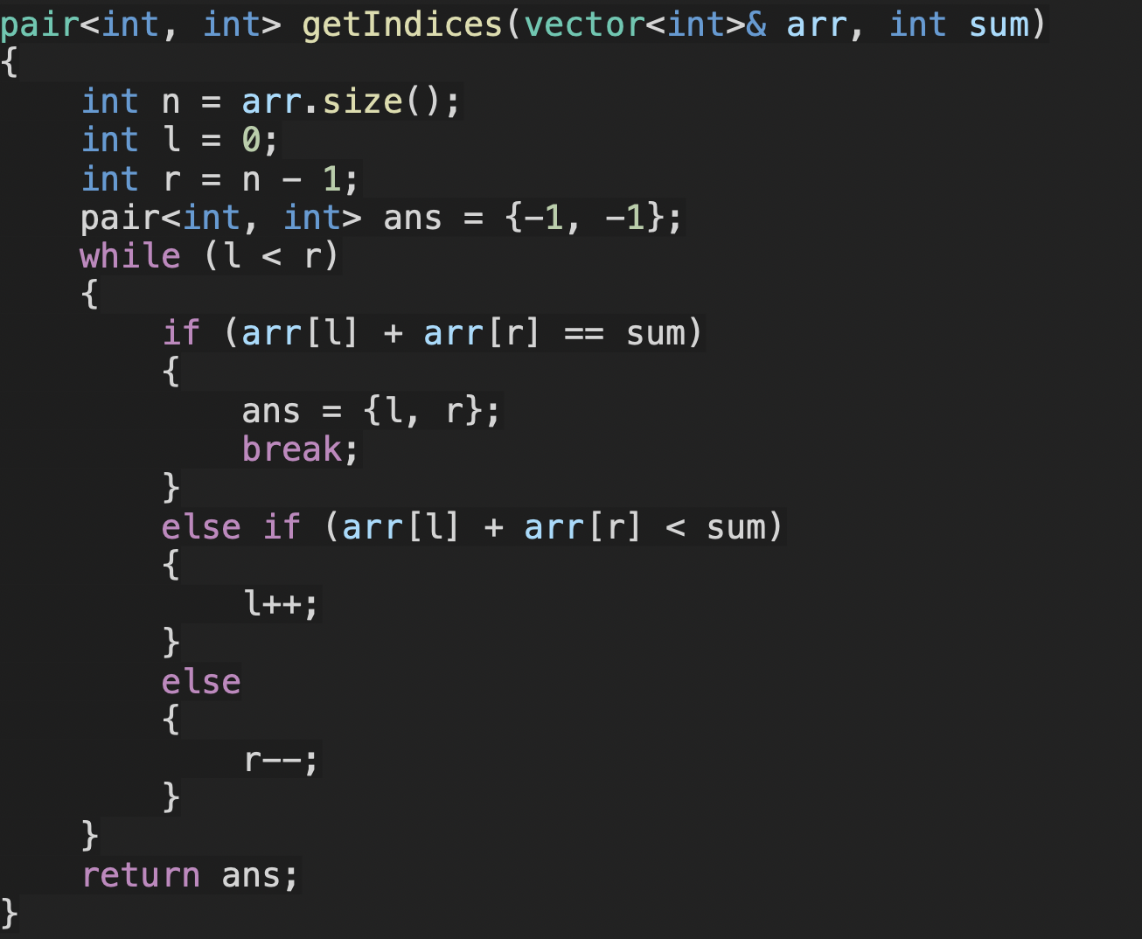

Slide 20
TIME COMPLEXITY ANALYSIS
Note: l is always incremented and never decremented (vice versa for r).
Therefore l can be incremented a maximum of n times and r can be
decremented a maximum of n times. Therefore the time complexity is O(N).

Slide 21
Quick Assessment
Given an array and a value, find if there is a triplet in array whose sum is equal to the given value.
Number of Pairs

Slide 22
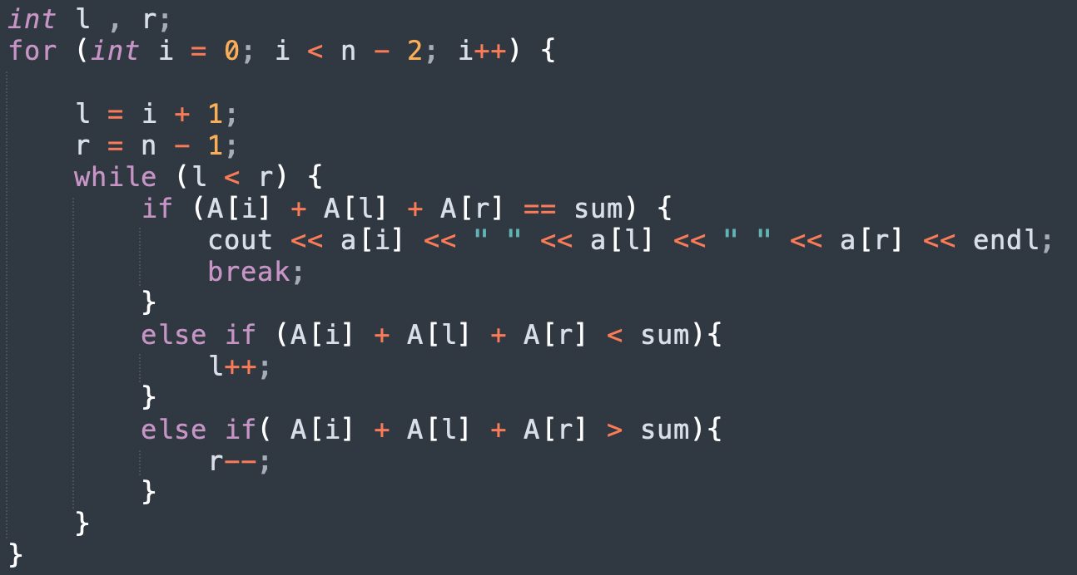
Question 1

Slide 23
Greedy Algorithm
Greedy is an algorithmic paradigm that builds up a solution piece by piece, always choosing the next piece that offers the most obvious and immediate benefit. Greedy algorithms are used for optimization problems.
An optimization problem can be solved using Greedy if the problem has the following property: At every step, we can make a choice that looks best at the moment, and we get the optimal solution of the complete problem.

Slide 24
Quick Assessment
Given the weights and values of N items, put these items in a knapsack of capacity W to get the maximum total value in the knapsack.
You are given n activities with their start and finish times. Select the maximum number of activities that can be performed by a single person, assuming that a person can only work on a single activity at a time.
Given the arrival and departure times of all trains that reach a railway station, the task is to find the minimum number of platforms required for the railway station so that no train waits. We are given two arrays that represent the arrival and departure times of trains that stop.

Slide 25
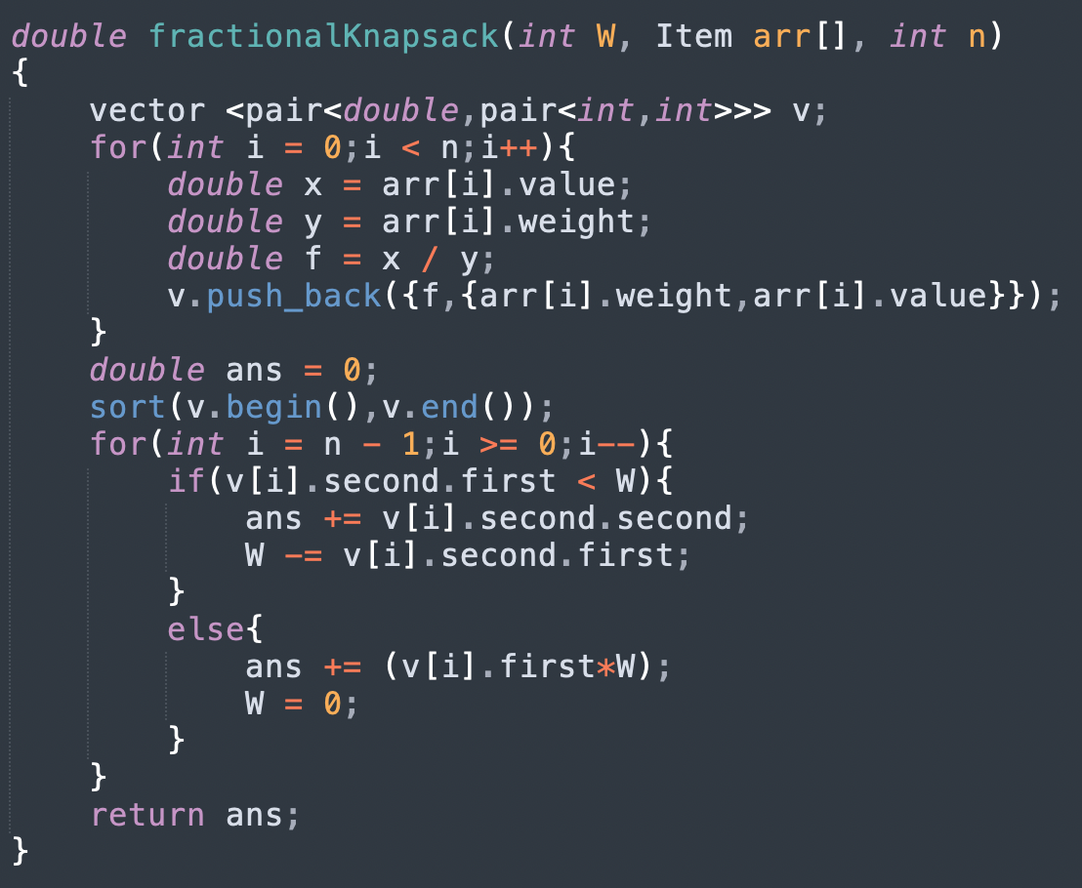
Question 1

Slide 26
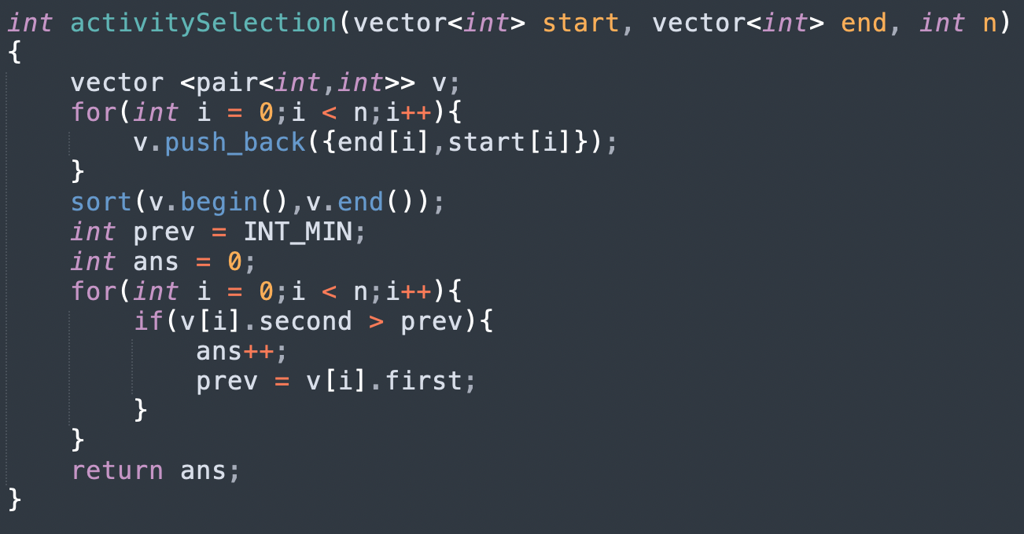
Question 2

Slide 27
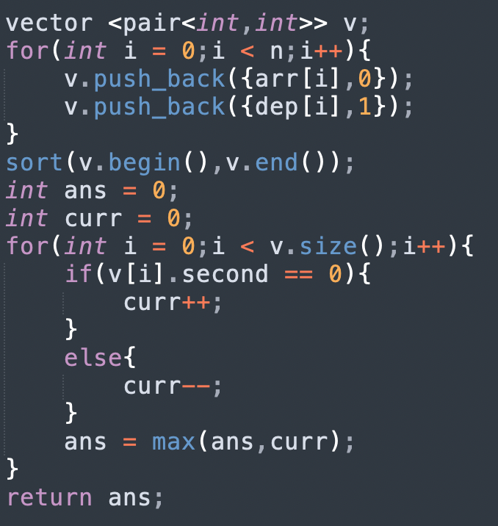
Question 3

Slide 28
Kadane’s Algorithm
The algorithm can be used to calculate maximum subarray sum in O(N).
It greedily picks only the largest sum prefix for every I.
Q.Given an array Arr[] of N integers. Find the contiguous sub-array(containing at least one number) which has the maximum sum and return its sum.

Slide 29
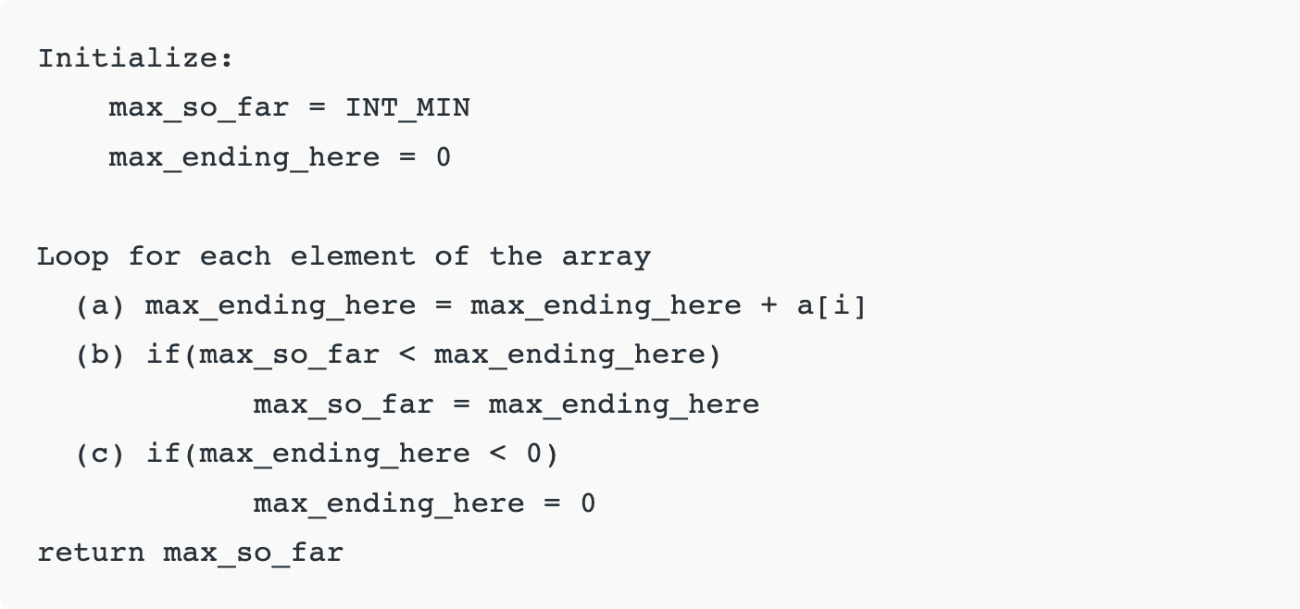

Slide 30
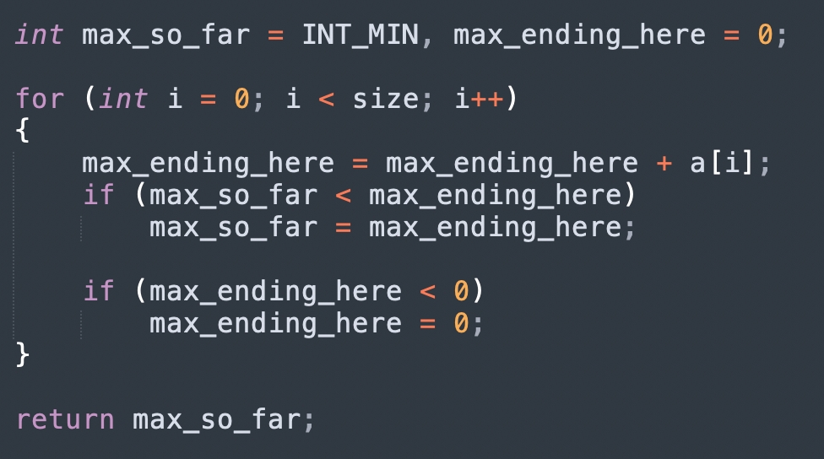

Slide 31
Recursion
The process in which a function calls itself directly or indirectly is called recursion and the corresponding function is called a recursive function.
A recursive function solves a particular problem by calling a copy of itself and solving smaller subproblems of the original problems. So we can say that every time the function calls itself with a simpler version of the original problem.
It is essential to know that we should provide a certain case in order to terminate this recursion process.

Slide 32
What is the base condition in recursion? In the recursive program, the solution to the base case is provided and the solution to the bigger problem is expressed in terms of smaller problems.
Q.Find Sum of first N natural numbers using recursion.

Slide 33
Quick Assessment
Implement power function using recursion.
Given a positive integer n, find the nth Fibonacci number.
F_{n} = F_{n-1} + F_{n-2.}
F₀ = 0 and F₁ = 1.
Given two sorted arrays, the task is to merge them in a sorted manner.

Slide 34
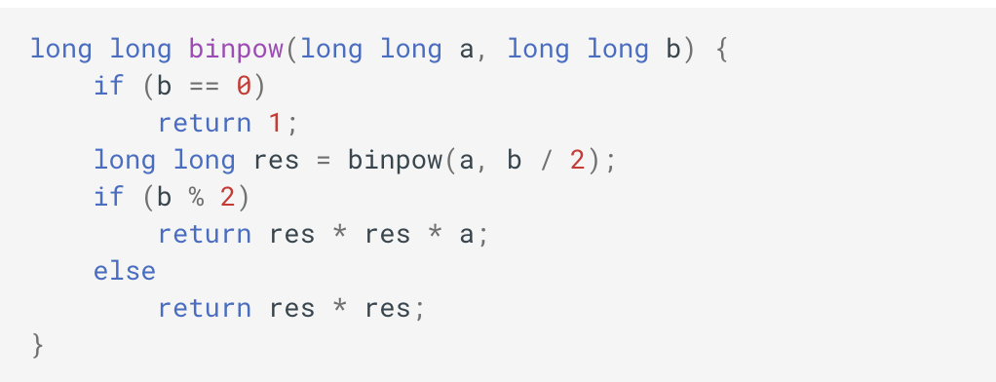
Question 1.

Slide 35
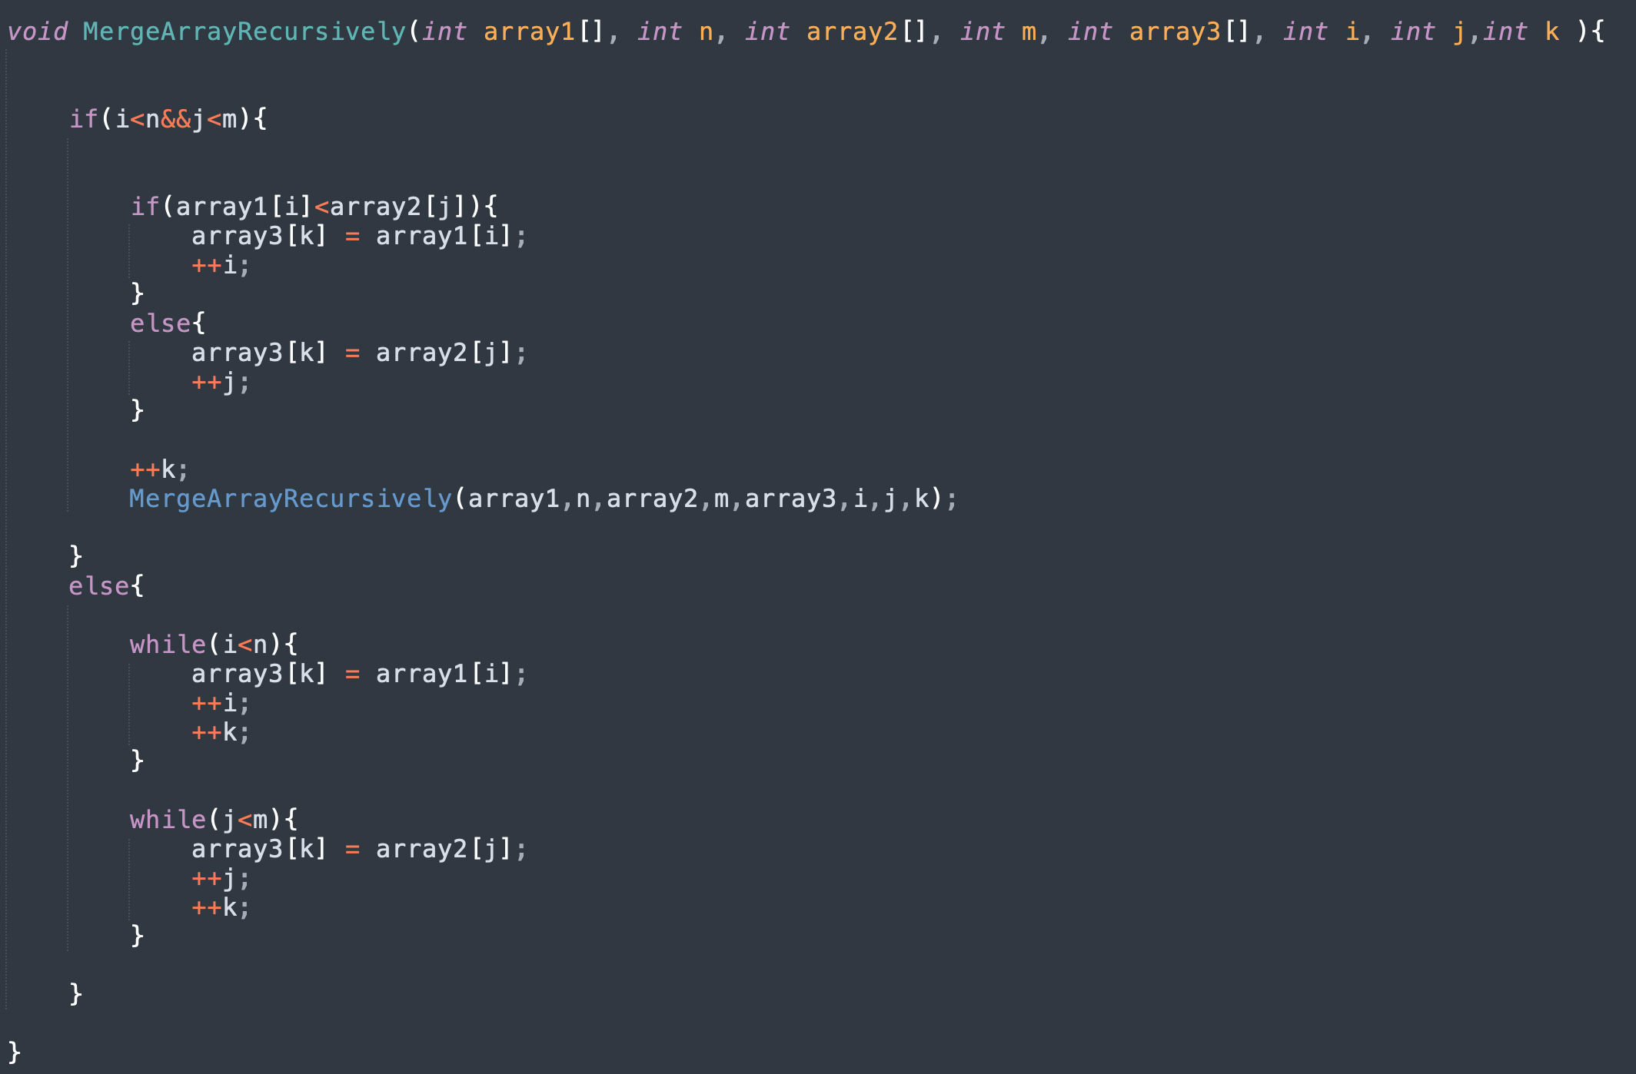
Question 3.

Slide 36
Quick Assessment
Given a set of non-negative integers, and a value sum, determine if there is a subset of the given set with sum equal to given sum.
Given weights and values of n items, put these items in a knapsack of capacity W to get the maximum total value in the knapsack.
In other words, given two integer arrays val[0..n-1] and wt.[0..n-1] which represent values and weights associated with n items respectively. Also given an integer W which represents knapsack capacity, find out the maximum value subset of val[] such that sum of the weights of this subset is smaller than or equal to W.

Slide 37
Backtracking
Backtracking is an algorithmic technique for solving problems recursively by trying to build a solution incrementally, one piece at a time, removing those solutions that fail to satisfy the constraints of the problem at any point in time.

Slide 38
Quick Assessment
A Maze is given as N*N binary matrix of blocks where source block is the upper left most block i.e., maze[0][0] and destination block is lower rightmost block i.e., maze[N-1][N-1]. A rat starts from source and has to reach the destination. The rat can move only in two directions: forward and down.

Slide 39
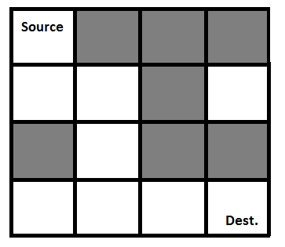
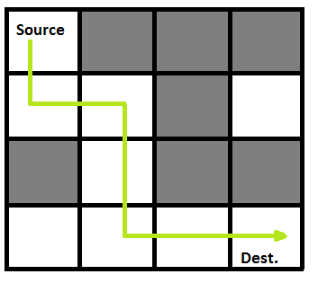

Slide 40
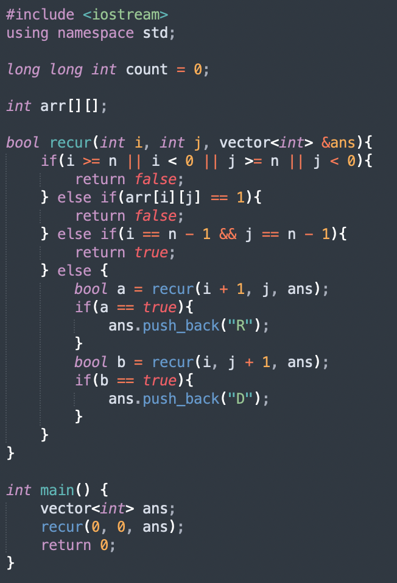

Slide 41
Quick Assessment
Given a set of non-negative integers, and a value sum, determine if there is a subset of the given set with sum equal to given sum. Print subset with given sum.
Given weights and values of n items, put these items in a knapsack of capacity W to get the maximum total value in the knapsack.
In other words, given two integer arrays val[0..n-1] and wt.[0..n-1] which represent values and weights associated with n items respectively. Also given an integer W which represents knapsack capacity, find out the maximum value subset of val[] such that sum of the weights of this subset is smaller than or equal to W. Print items in knapsack.

Slide 42
Sorting
Sorting refers to arranging data in a particular format.
A Sorting Algorithm is used to rearrange a given array or list elements according to a comparison operator on the elements. The comparison operator is used to decide the new order of elements in the respective data structure.

Slide 43
Bubble Sort Algorithm
Bubble Sort is the simplest sorting algorithm that works by repeatedly swapping the adjacent elements if they are in the wrong order.
This algorithm is not suitable for large data sets as its average and worst-case time complexity is quite high.

Slide 44
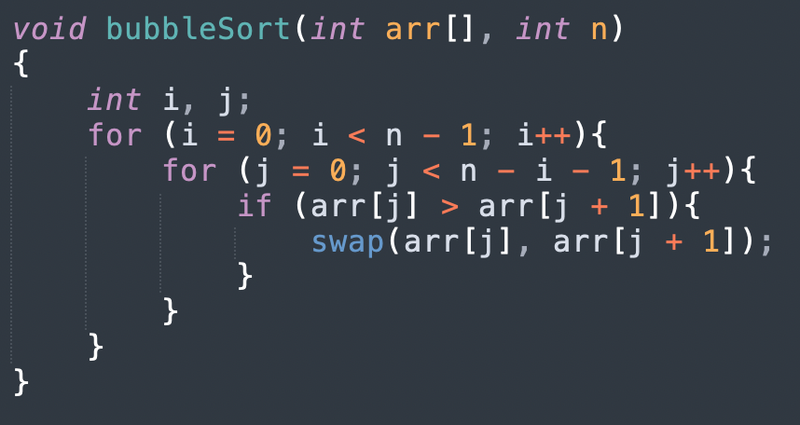

Slide 45
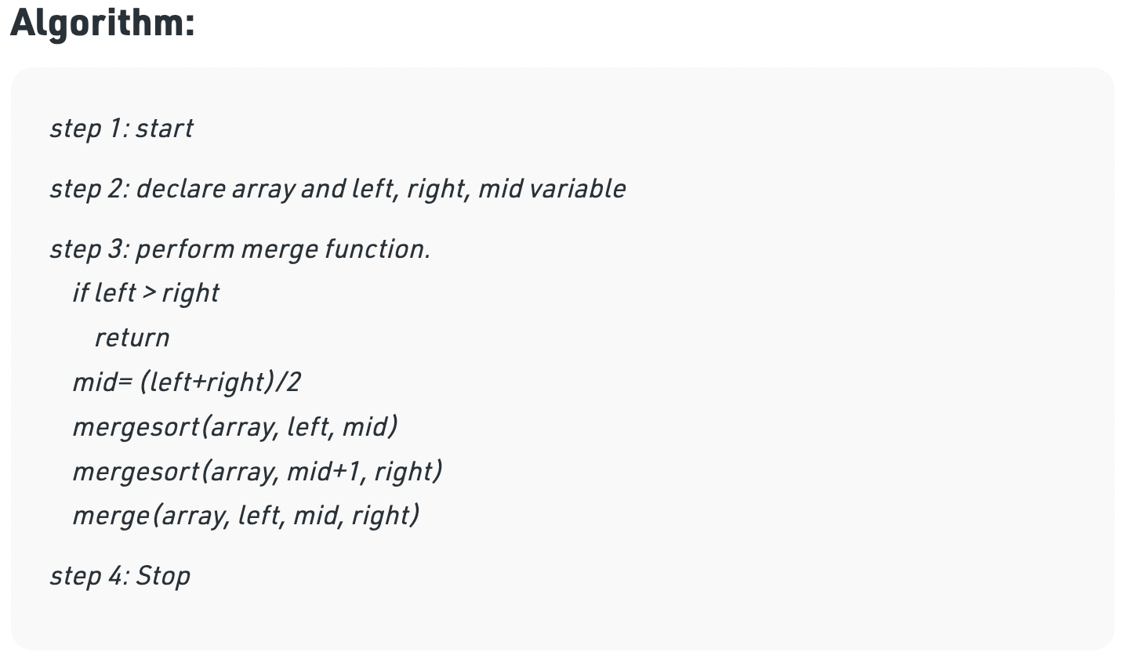
Merge Sort Algorithm
Merge Sort algorithm is a sorting algorithm that is based on the Divide and Conquer paradigm. In this algorithm, the array is initially divided into two equal halves and then they are combined in a sorted manner.

Slide 46
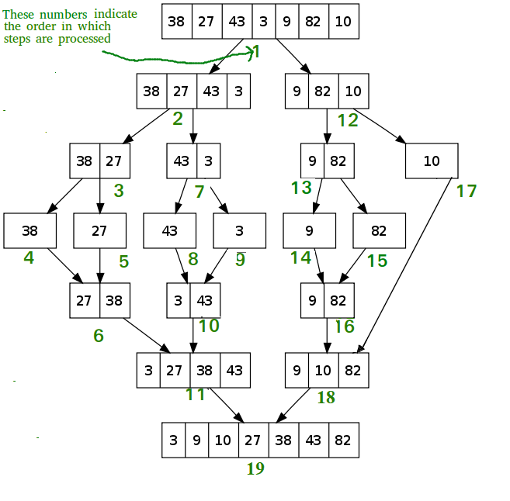

Slide 47
Quick Assessment
Given an array of integers. Find the Inversion Count in the array.
Formally, two elements a[i] and a[j] form an inversion if a[i] > a[j] and i < j.

Slide 48
Precomputation

